Slide 1






Relationships Among Patterns in Classroom Discourse and Student Learning Performances
Beth Covitt, Christie Morrison Thomas, Qinyun Lin, Elizabeth de los Santos, & Charles W. Anderson
NARST Annual Meeting
April 2, 2019 – Baltimore, MD
Notes:
Additional authors on this paper include Christie Morrison Thomas, Qinyun Lin, and Andy Anderson. The title of our paper is relationships among patterns in classroom discourse and student learning performances. That said, while student learning performances are what we are ultimately interested in supporting, most of the time in this presentation will be devoted to digging into discourse in Carbon TIME classrooms.

Slide 2
Research Questions
What performances are being scaffolded through discourse in Carbon TIME classrooms?
How do classroom discourse patterns relate to student assessment performance patterns?
Notes:
The extensive data set collected by the Carbon TIME project provides a unique opportunity to both examine the nature of discourse in project classrooms and to connect discourse characteristics to students’ post learning assessment performances.

Slide 3
Analytic Framework
We use evidence from classroom lessons and student performances to interrogate how attributes of classroom discourse relate to performances students produce after Carbon TIME learning.
Classroom Discourse
What do teacher and students do during lessons and why?
Performances
How do students perform after Carbon TIME lessons?
Student Class Performances
How do students question, investigate, write, and talk?
Scaffolding
How are student performances scaffolded by teacher and discourse?
Assessment
How do formative assessment, grading, and self-assessment happen?
Written Assessments
Focus Group Interviews
Notes:
We’re interested in how what happens in the classroom can predict what students are able to do after their Carbon TIME learning experience. In particular, we’re looking at what they are doing in class. For example, how do students question, investigate, write, and talk; and how are their classroom performances scaffolded by the teacher and by the classroom discourse?

Slide 4
Cognitive Apprenticeship
Classroom Discourse
What do teacher and students do during lessons and why?
Performances
How do students perform after Carbon TIME lessons?
WYDIWYL
Students’ classroom performances predict what they will be able to do outside of the classroom.
Cognitive apprenticeship creates opportunities to practice goal performances with scaffolding, social support and gradual transfer of responsibility.
(Collins, Brown & Newman, 1989)
Notes:
Our theoretical assumption is that if students have opportunities to practice goal performances with scaffolding, social support, and gradual transfer of responsibility in class, then they’ll be more likely to be able to produce goal performances after Carbon TIME. WYDIWYL is an abbreviation of this idea that stands for “what you do is what you learn.”

Slide 5
Mixed Methods Design
Case study data (17 classrooms)
  Classroom video
  Student focus group interviews
  Written assessments
Examples from two classrooms representing distinct discourse patterns
Submission will rely on full case study data set
Notes:
We’re working with case study data from 17 classrooms. In this talk, I’ll focus on two lessons from two classrooms representing different discourse patterns.

Slide 6
Example Classrooms
Mr. Harris
High school in a large suburb
15% FRL
90% White, 8% Other, 2% Asian
Ms. Callahan
Pull out math and science high school in a midsize city
1% FRL
79% White, 17% Asian, 4% Other
Notes:
Our first classroom is with Mr. Harris, who teaches high school biology in a large suburb. The second classroom is with Ms. Callahan, who teaches biology at a high school math and science school. Both of these schools are in relatively affluent communities that are not particularly diverse, and both teachers are themselves white.

Slide 7
Carbon TIME Process Tools: Student Storyline
How students are figuring out the movement and transformation of matter and energy
Explanations Tools
Evidence-Based Arguments Tool
Predictions & Planning Tool
Molecular Models
Evidence-
Based
Arguments
Inquiry
(up the triangle)
Explanations
(down the triangle)
Models:
Chemical change
Expressing Ideas Tool
Observe
Patterns:
Patterns of change in mass & BTB;
biomass pyramid; global patterns
Pretest
Predict
and
Express Ideas
Observations
Growth, movement, decay, burning,
biomass pyramid, climate change
More Support
Less Support
Next Unit
Start
Establish the Problem
Foundational knowledge
Posttest
Notes:
In the lesson we look at from Mr. Harris’s class, the students were working with an evidence-based arguments tool designed to scaffold students in coordinating evidence, initial conclusions, and unanswered questions from an ethanol burning investigation. In Ms. Callahan’s class lesson, students were working with an explanations tool designed to scaffold students in producing and refine explanations for cow cellular respiration that trace matter and energy through the process.

Slide 8
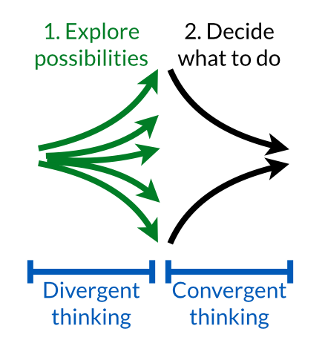
Classroom Context:
Carbon TIME Discourse Routine
Steps in a Carbon TIME Discourse Routine
Introduction
Private writing
Sharing ideas
Consensus-seeking discussion accompanied by public writing and revision
Notes:
For each classroom, we’ll look at a lesson that more or less follows a Carbon TIME discourse routine around the use of the tool. Each discourse routine is designed to begin by scaffolding divergent thinking and then moving to scaffolding convergent thinking. The steps include an introduction, private writing time, sharing ideas, and then consensus-seeking discussion and revision.

Slide 9
Research Question One
What performances are being scaffolded through discourse in Carbon TIME classrooms?
Notes:
So let’s take a look at two Carbon TIME classrooms.

Slide 10
Mr. Harris’s Class
We visit Mr. Harris’s high school class during the Evidence-based Arguments (EBA) Tool for Ethanol Burning discourse routine.
EBA Tool Target Performance: Students…
use data from their investigations to develop evidence-based arguments about matter movements and matter changes when ethanol burns, and
identify unanswered questions about matter movement and matter change that the data are insufficient to address.
Notes:
First, we visit Mr. Harris’s class during the discourse routine around the Evidence-Based Arguments Tool for an ethanol burning investigation. There’s a two part target performance. First, students should use data from their investigations to develop evidence-based arguments about matter movements and matter changes when ethanol burns. Second, students should identify unanswered questions about matter movement and matter change that their ethanol burning data were insufficient to answer.

Slide 11
1. Introduction to Tool
Mr. Harris introduces the EBA Tool as an opportunity to make, “arguments based on the evidence we saw.” He reviews the Three Questions and encourages students to use them as a guide.
Movement Question: Where are atoms moving?
Carbon Question: What is happening to carbon atoms?
Energy Question: What is happening to chemical energy?
Notes:
Mr. Harris introduces the EBA Tool as an opportunity to make, “arguments based on the evidence we saw.” He reviews three questions that are designed to scaffold students toward the target performance. Those questions are about movement, Carbon, and energy.

Slide 12
1. Introduction to Tool (cont.)
Notes:
The EBA tool asks students for evidence, conclusions, and unanswered questions about each of the three questions. Mr. Harris encourages students to start with the middle column (conclusions) and then consider the first column (evidence). He talked with a Carbon TIME coach and Mr. Harris thinks this order will make the most sense for his students.
He mentions the unanswered questions column when introducing the Tool, but does not expand.

Slide 13
2. Private Writing
Mr. Harris walks around the class as students work, but doesn’t look at students’ writing.
He provides some direction; after a minute he says, “…remember in the conclusion box we’re answering the question. In the evidence box you’re giving your reason why based on the evidence we see.”
Students work for about nine minutes.
Mr. Harris closes private writing time with a comment about unanswered questions, “...remember about that last column, the unanswered questions, how that there are still things that you really can’t know yet.”
Notes:
During private writing time, Mr. Harris walks around the class, but he doesn’t look at students’ writing.
He provides some direction; after a minute he says, “…remember in the conclusion box we’re answering the question. In the evidence box you’re giving your reason why based on the evidence we see.”
Students work for nine minutes.
Mr. Harris closes private writing time with a comment about unanswered questions, “...remember about that last column, the unanswered questions, how that there are still things that you really can’t know yet.”

Slide 14
3. Sharing Ideas
Next, Mr. Harris asks students to talk about two things with a partner:
“What is the thing that you’re like rock solid about?”
“What is the thing you’re least confident about?”
Students talk with a partner for two minutes.
Notes:
Next, Mr. Harris asks students to talk about two things with a partner:
“What is the thing that you’re like rock solid about?”
“What is the thing you’re least confident about?”
Students talk with a partner for two minutes.

Slide 15
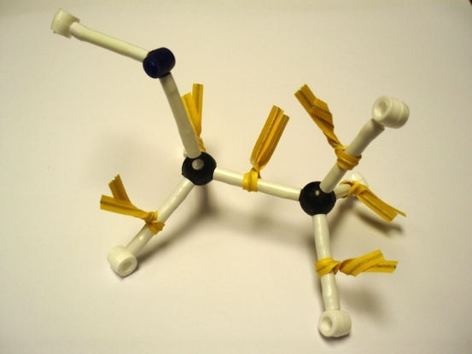
4. Class Poll
In place of a consensus-seeking discussion, work with the Tool ends with a poll.
Students put their heads down and raise their hands to answer…
Did you use the word BTB ever in your writing?
Did you use the words mass or weight in talking about your evidence?
Which row was most challenging for you – 1, 2 or 3?
After finishing the poll, Mr. Harris transitions students to group work on the next activity, ethanol molecular models.
Notes:
In place of a consensus-seeking discussion, work with the Tool ends with a poll.
Students put their heads down and raise their hands to answer…
Did you use the word BTB ever in your writing?
Did you use the words mass or weight in talking about your evidence?
Which row was most challenging for you – 1, 2 or 3?
After finishing the poll, Mr. Harris transitions students to group work on the next activity, ethanol molecular models.

Slide 16
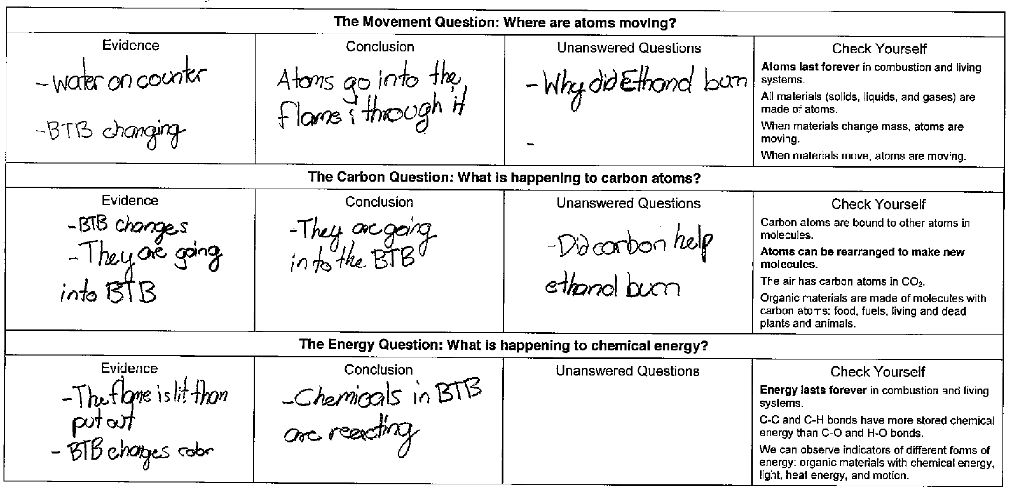
Example Lesson Performance
Mass of ethanol in petri dish decreased
Atoms left the ethanol and went into the air
What happened to the atoms that left the petri dish?
Notes:
Here’s an example student in class performance. We can compare the students’ movement question responses to the target performance. For evidence, the student notices water and BTB, but fails to identify mass change evidence.
In the conclusion column, the student concludes that atoms are going through the flame but doesn’t identify where the atoms came from or where they went to.
The student poses a pretty good unanswered question, “Why did ethanol burn?,” but it’s not a question that addresses the movement question concerning where atoms are moving.
The student writes only one other unanswered question, and it, similarly, does not connect to the target performance.
This student has some ideas about what’s going on and is in a good position to make a contribution to a consensus seeking discussion, but could benefit from scaffolding to refine their answers to achieve the target performance.
By administering a class poll and then moving to the molecular modeling activity, Mr. Harris passes on an opportunity to scaffold students to meet the target performance for the EBA Tool.

Slide 17
Ms. Callahan’s Class
Next, we visit Ms. Callahan’s science high school class during the Explanations Tool for How Cows Move and Function: Cellular Respiration discourse routine.
Target performance: Students explain how matter moves and changes and how energy changes during cellular respiration in a cow’s cells (connecting macroscopic observations with atomic-molecular models and using principles of conservation of matter and energy).
Notes:
Next, we visit Ms. Callahan’s science high school class during the Explanations Tool for How Cows Move and Function discourse routine.
Target performance: Students explain how matter moves and changes and how energy changes during cellular respiration in a cow’s cells (connecting macroscopic observations with atomic-molecular models and using principles of conservation of matter and energy).

Slide 18
1. Introduction to Tool
Ms. Callahan begins with reminders about what the class has been working on (mealworm investigation data, molecular modeling kit) and asks if everyone is feeling confident. She says that at the end of the unit she wants students to be able to, “say not only for Carbon TIME, but for life, this is exactly what happens when the organism grows.”
Ms. Callahan sets the purpose of the Explanations Tool lesson as, “we’re going to actually figure out what’s going on in these cow muscle cells. Get ready to explain.”
Next, the class reviews the EBA Tool. Ms. Callahan highlights how the product of CO₂ might have something to do with the missing mass students found in their mealworm investigation evidence.
Notes:
Ms. Callahan begins with reminders about what the class has been working on and asks if everyone is feeling confident. She says that at the end of the unit she wants students to be able to, “say not only for Carbon TIME, but for life, this is exactly what happens when the organism grows.”
Ms. Callahan sets the purpose of the Explanations Tool lesson as, “we’re going to actually figure out what’s going on in these cow muscle cells. Get ready to explain.”
Next, the class reviews the EBA Tool. Ms. Callahan highlights how the product of CO₂ might have something to do with the missing mass students found in their mealworm investigation evidence.

Slide 19
2. Private Writing
Ms. Callahan sets students to their private writing by saying, “Alright, so now it’s your turn to sort of solo artist figure out some explanations for this. I want you to be specific. Use your evidence. Use your thoughts. Start putting all these things together.”
Students work for 10 minutes.
Notes:
Ms. Callahan sets students to their private writing by saying, “Alright, so now it’s your turn to sort of solo artist figure out some explanations for this. I want you to be specific. Use your evidence. Use your thoughts...”
Students work for 10 minutes.

Slide 20
3. Sharing Ideas
Next comes partner work to share ideas…
“…Don’t just throw your paper at them and have them look at it. Talk to them. Communicate and work your way through. Get out a different colored pen and pencil. I want you to circle any areas that you have in common and then if you want to add items in that’s fine. Just do it in a different color pen or pencil. You have a lot more in common but maybe still some differences, which could be interesting. So talk to each other. Use your words. Let’s go. Four minutes.”
Notes:
Next comes partner work to share ideas…
“…Don’t just throw your paper at them and have them look at it. Talk to them. Communicate and work your way through. Get out a different colored pen and pencil. I want you to circle any areas that you have in common and then if you want to add items in that’s fine. Just do it in a different color pen or pencil. You have a lot more in common but maybe still some differences, which could be interesting…”
She gives students four minutes to talk.

Slide 21
4. Consensus-Seeking Discussion
It’s difficult to encapsulate the consensus discussion, which extended for 36 minutes and included teacher and student talk that was sometimes very specific to the Tool, and at other times related, but delving into content students were curious about beyond core Carbon TIME material (e.g., tracing water through urine and milk in the body; function of organs including kidneys, gall bladder, and pancreas; discussing why urine is yellow; and ATP). Ms. Callahan often refers to the Three Questions and asks students if and how their responses are following the rules.
Notes:
It’s difficult to encapsulate the consensus discussion, which extended for 36 minutes and included teacher and student talk that was sometimes very specific to the Tool, and at other times related, but delving into content students were curious about beyond core Carbon TIME material (e.g., tracing water through urine and milk in the body; function of organs including kidneys, gall bladder, and pancreas; discussing why urine is yellow; and ATP). Ms. Callahan often refers to the Three Questions and asks students if and how their responses are following the rules.

Slide 22
4. Consensus-Seeking Discussion (cont.)
Ms. Callahan uses talk moves to scaffold students in figuring out. Sometimes she solicits short responses, but often she asks for extended explanations.
“Add on to what Emma is saying. So what does it mean getting started breaking down stuff? Logan?”
“So Riley, tell me what happens next. We’ve got grass in the mouth. There’s some saliva going on. It’s breaking down the grass. Maybe the glucose. We don’t know yet. What happens next?”
“I want to hear Matt. Is it still grass in the stomach?”
“ Now I want to hear from Ganesh. Tell me what happens after it goes out of the stomach.”
Notes:
Ms. Callahan uses talk moves to scaffold students in figuring out. Sometimes she solicits short responses, but often she asks for extended explanations.
“Add on to what Emma is saying. So what does it mean getting started breaking down stuff? Logan?”
“So Riley, tell me what happens next. We’ve got grass in the mouth. There’s some saliva going on. It’s breaking down the grass. Maybe the glucose. We don’t know yet. What happens next?”
And the discussion goes on…

Slide 23
4. Consensus-Seeking Discussion (cont.)
Close of discussion scaffolds students in checking if they have good explanations. Ms. Callahan queries students about confidence and consensus.
T: Good. Good. Note this is a pretty solid answer they’re saying glucose is going into the cell. Pretty important. Do you have an arrow showing oxygen or O₂ going into the cow’s cells?
Ss: Yes.
T: Is that pretty universally confident? You’re good with that?
Ss: Yes.
T: Excellent. Alright. Coming out do you have CO₂?
T: Did you make it very clear that you’re separating the ideas of matter and energy?
Ss: Yes.
T: At no point did you say glucose was converted into energy?
Ss: No.
T: Promise?
Ss: Yes.
T: Good! I’m pretty excited about some of the common ground we have. That you’re all in agreement on things that are going in and out after your molecular modeling kits. Which is great. So, we’re good. We’re good.
Notes:
Close of discussion scaffolds students in checking if they have good explanations and refining their explanations as needed. Ms. Callahan queries students about confidence and consensus.
T: Did you make it very clear that you’re separating the ideas of matter and energy?
Ss: Yes.
T: At no point did you say glucose was converted into energy?
Ss: No.
T: Promise?
Ss: Yes.
T: Good! I’m pretty excited about some of the common ground we have. That you’re all in agreement on things that are going in and out after your molecular modeling kits…

Slide 24
Scaffolded Performances
Discourse Routine | Mr. Harris’s Class | Ms. Callahan’s Class
1. Introduction | Highlights Three Questions and three columns, but doesn’t relate to driving question or phenomenon. | Connects to driving question and students’ lives to motivate explaining phenomenon.
2. Private Writing | Scaffolded to use Three Questions and different column order to make arguments based on evidence. | Scaffolded to use Three Questions and evidence to write individual explanations for “what’s going on in these cow muscle cells.”
3. Sharing Ideas | Students compare what they feel more/less confident about. | Students compare ideas and engage in self-assessment and revision.
4. Consensus-seeking | Poll provides 1D info about students, but misses opportunity to scaffold students toward unanswered questions leading to molecular modeling activity. | Explicit consensus-seeking. Open-ended at first, then didactic at end as everyone checks/refines their explanations.
Notes:
Overall, we can see some key differences between discourse in Mr. Harris’s and Ms. Callahan’s class. For example, in the introduction and lead up to private writing, Mr. Harris scaffolds use of the three questions, but doesn’t explicitly refer to the phenomenon of ethanol burning. Ms. Callahan, in contrast, makes sure to explicitly connect the task to the need to explain what’s happening in the cow’s muscle cells. Students in Mr. Harris’s class share ideas about what they feel confident about or not. Ms. Callahan’s students compare their actual explanations and self-assess and revise their ideas. Finally, while Mr. Harris’s students raise their hands to answer questions in a poll, Ms. Callahan’s class explains what happens inside a cow when it grows, discuss things like how the body uses water, and check that they all have written good explanations on their tools.

Slide 25
Research Question Two
How do classroom discourse patterns relate to student assessment performance patterns?
Notes:
Next we look briefly at how classroom discourse relates to student performance.

Slide 26
Students’ Assessment Performances
Notes:
This slide from Qinyun’s presentation shows how Mr. Harris’s and Ms. Callahan’s students did on the Carbon TIME written assessments. Mr. Harris’s students performed lower than predicted by the statistical model (accounting for FRL and pretest) and Ms. Callahan’s students performed higher than predicted. We would suggest that the nature of classroom discourse and what students are actually doing in Mr. Harris’s and Ms. Callahan’s classes can help explain this result.

Slide 27
Limitations
Only two teachers
Unanswered causal questions (e.g., impact of differences in student populations, context)
Summary
Capacity for 3D performances results from engaging in 3D classroom practices
Teachers who scaffold students’ 3D practices orchestrate classroom discourse in carefully planned and skillful ways
These analyses can help us analyze both key attributes of success and potential pitfalls
Notes:
In this presentation, we only examined one lesson each for two teachers. We’ll look at all 17 case teachers’ classrooms in our full analysis. We’re also limited by not controlling for other possible factors that can influence students’ post learning performances, such as differences in student populations and school contexts. Contextual factors, in particular, will be addressed by Christie Thomas in the next paper. However, classroom discourse still opens up the black box of instruction to provide a potentially powerful lens for explaining learning gains. Successful teachers are orchestrating classroom discourse in carefully planned and skillful ways. Analyzing classroom discourse can help us identify both successful approaches and potential pitfalls for supporting students’ capacity to produce three-dimensional performances.

Slide 28
Mr. Harris’s Student Performance Example
Coach: What’s happening to carbon atoms when you grow? Is there anything... is carbon in there at all?
S: You breathe out, you breathe out... carbon is out, yeah.
…
Coach: So... do you breathe out all the carbon, or...?
S: Some of it. Like... Didn’t [the teacher] say it like, splits apart? That’s like, how the digestion system like, works too. And then when you like, breathe it out, that’s like your food, basically. (pause) I guess.
Notes:
Skip slide

Slide 29
Ms. Callahan’s Student Performance Example
The carbon atom starts off as, we’ll say a glucose molecule and it enters our body when we eat it and then it goes down into your small intestine and your stomach, and it starts to get broken down from that—or no. Sorry. It enters in a starch within a glucose—or a glucose within a starch. There we go. In digestion it gets broken down to where this carbon atom is now only in a little glucose molecule and then it’s able to enter into the blood stream and go into your arm. Once it reaches a cell, it kind of diffuses into that cell. I think it just randomly diffuses. It may just go like whoop and then enter. From there it can build back into a polymer, build back into something, or it can go through cellular respiration where it will eventually get released as CO₂.
Notes:
Skip slide

